Slide 1
MULTI REVIEWING SYSTEM
By:
Ajay Kumar(737-122)
Chandra kiran(737-129)
Rahul datta(737-154)

Slide 2
Actors with Use cases:
Client | Reviewer | System
Uploads Wardrobe list | Selects and give opinion on list | Analyses opinion
Uploads images of art , designs | Gives Feed back on design | Analyses feedback
Uploads features of Newly launching products | Gives Constructive Feedback | Analysis of Feedback
If Feedback of any particular is useful graded with stars |  | Pie chart of result will be displayed

Slide 3
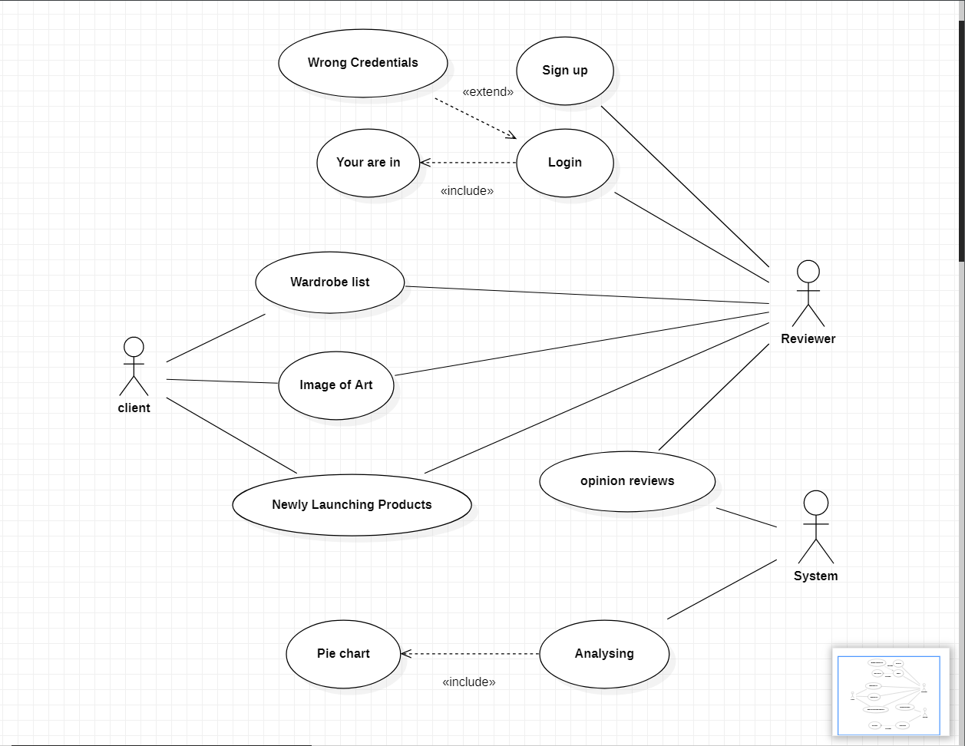
Use Case Diagram:

Slide 4
Use Case Descriptions: Use Case-1:
Name : Wardrobe
Actors : Client , Reviewer
Description : Reviews the Wardrobe
Pre-Conditions : Picture upload
Post-Conditions : Opinion of Reviewer
Main Flow:
Client | Reviewer
1.Chooses the Wardrobe upload option. Uploads the Wardrobe list
 | 2.Logins with credentials
 | 3. Selects the giving option for Wardrobe opinion.Gives the feedback

Slide 5
Use Case-2:
Name : Art , Design
Actors : Client , Reviewer
Description : Reviews the Art and Design
Pre-Conditions : Picture upload
Post-Conditions : Opinion of Reviewer
Main Flow:
Client | Reviewer
1.Chooses the Art , Design upload option. Uploads the image
 | 2. Logins with credentials
 | 3. Selects the giving opinion for Art ,Design option.Gives the feedback

Slide 6
Use Case-3:
Name : Newly Launching Products
Actors : Client , Reviewer
Description : Reviews the newly launching products
Pre-Conditions : Picture upload
Post-Conditions : Opinion of Reviewer
Main Flow:
Client | Reviewer
1.Chooses the Newly launching product features upload option. Uploads the image
 | 2. Logins with credentials
 | 3. Selects the giving opinion for new launching products option.Gives the feedback

Slide 7
Use Case-4:
Name : Analysis
Actors : Reviewer , System
Description : Analyses the all reviews of all reviewers
Pre-Conditions : reviews
Post-Conditions : displays Pie chart
Main Flow:
Reviewer | System
1.Gives review for (Art , Design , Newly launching products)
 | 2. Analyses reviews of all persons
 | 3. Plots and displays the Pie Chart for Number of Positive , Negative and neutral reviews

Slide 8
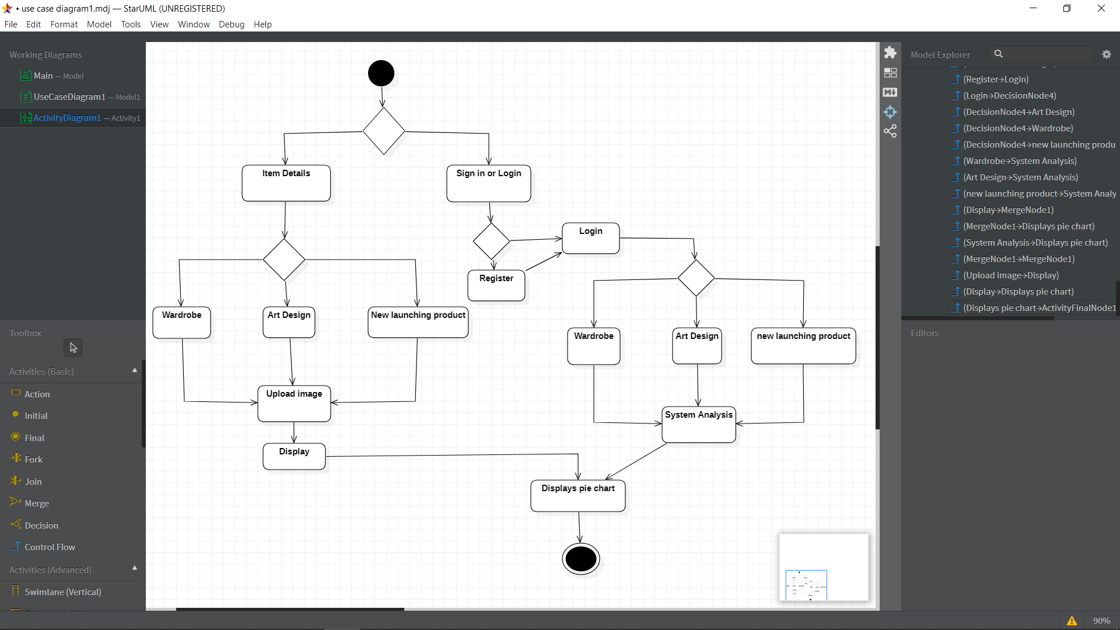
Activity Diagram:

Slide 9
Thank you

